Slide 1
Introduction to UML

Slide 2
Design phase
design: specifying the structure of how a software system will be written and function, without actually writing the complete implementation
a transition from "what" the system must do, to "how" the system will do it
What classes will we need to implement a system that meets our requirements?
What fields and methods will each class have?
How will the classes interact with each other?

Slide 3
What is UML?
Unified Modeling Language
OMG Standard, Object Management Group
Based on work from Booch, Rumbaugh, Jacobson
UML is a modeling language to express and design documents, software
Particularly useful for OO design
Not a process, but some have been proposed using UML
Independent of implementation language

Slide 4
Why use UML
Open Standard, Graphical notation for
Specifying, visualizing, constructing, and documenting software systems
Language can be used from general initial design to very specific detailed design across the entire software development lifecycle
Increase understanding/communication of product to customers and developers
Support for diverse application areas
Support for UML in many software packages today (e.g. Rational, plugins for popular IDE’s like NetBeans, Eclipse)
Based upon experience and needs of the user community

Slide 5
Why use UML
as a sketch: to communicate aspects of system
forward design: doing UML before coding
backward design: doing UML after coding as documentation
often done on whiteboard or paper
used to get rough selective ideas
as a blueprint: a complete design to be implemented
sometimes done with CASE (Computer-Aided Software Engineering) tools
as a programming language: with the right tools, code can be auto-generated and executed from UML
only good if this is faster than coding in a "real" language

Slide 6
Brief History
Inundated with methodologies in early 90’s
Booch, Jacobson, Yourden, Rumbaugh
Booch, Jacobson merged methods 1994
Rumbaugh joined 1995
1997 UML 1.1 from OMG includes input from others, e.g. Yourden
UML v2.0 current version

Slide 7
Building Blocks
The basic building blocks of UML are:
model elements (classes, interfaces, components, use cases, etc.)
relationships (associations, generalization, dependencies, etc.)
diagrams (class diagrams, use case diagrams, interaction diagrams, etc.)
Simple building blocks are used to create large, complex structures
cf. elements, bonds and molecules in chemistry
cf. components, connectors and circuit boards in hardware

Slide 8
UML – Unified Modeling Language
Union of all Modeling Languages
Use case diagrams
Class diagrams
Object diagrams
Sequence diagrams
Collaboration diagrams
Statechart diagrams
Activity diagrams
Component diagrams
Deployment diagrams
– ….
Very big, but a nice standard that has been embraced by the industry.

Slide 9
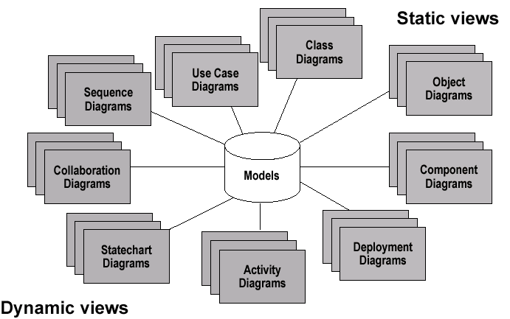
Models, Views, Diagrams

Slide 10

What is a Class Diagram?
A class diagram is a view of the static structure of a system
Models contain many class diagrams
Class diagrams contain:
Packages, classes, interfaces, and relationships
Notation:
Package
Class Name
<<Interface>>
Name
Interface Name

Slide 11
UML class diagrams
UML class diagram: a picture of
the classes in an OO system
their fields and methods
connections between the classes
that interact or inherit from each other
Not represented in a UML class diagram:
details of how the classes interact with each other
algorithmic details; how a particular behavior is implemented

Slide 12
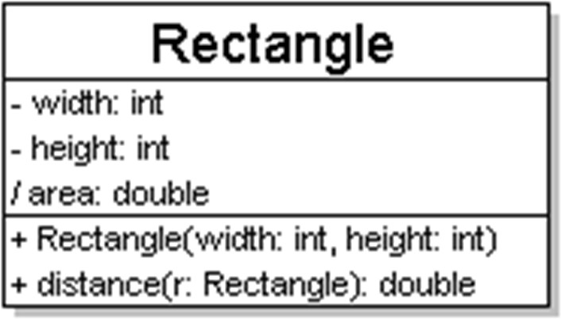
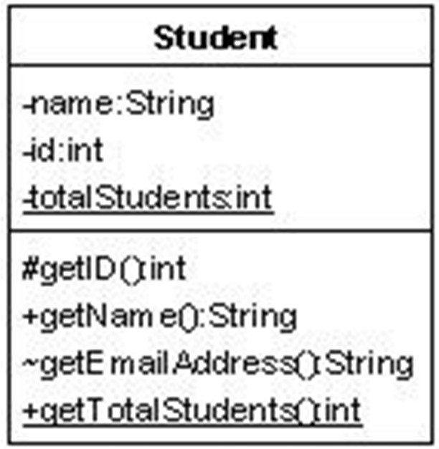
Diagram of one class
class name in top of box
write <<interface>> on top of interfaces' names
use italics for an abstract class name
attributes (optional)
should include all fields of the object
operations / methods (optional)
may omit trivial (get/set) methods
but don't omit any methods from an interface!
should not include inherited methods

Slide 13
Class attributes (= fields)
attributes (fields, instance variables)
– visibility name : type [count] = default_value
– visibility: | + | public
 | # | protected
 | - | private
 | ~ | package (default)
 | / | derived
underline static attributes
derived attribute: not stored, but can
be computed from other attribute values
“specification fields “ from CSE 331
attribute example:
- balance : double = 0.00

Slide 14
Class operations / methods
operations / methods
– visibility name (parameters) : return_type
– visibility: | + | public
 | # | protected
 | - | private
 | ~ | package (default)
underline static methods
parameter types listed as (name: type)
omit return_type on constructors and when return type is void
method example:
+ distance(p1: Point, p2: Point): double

Slide 15
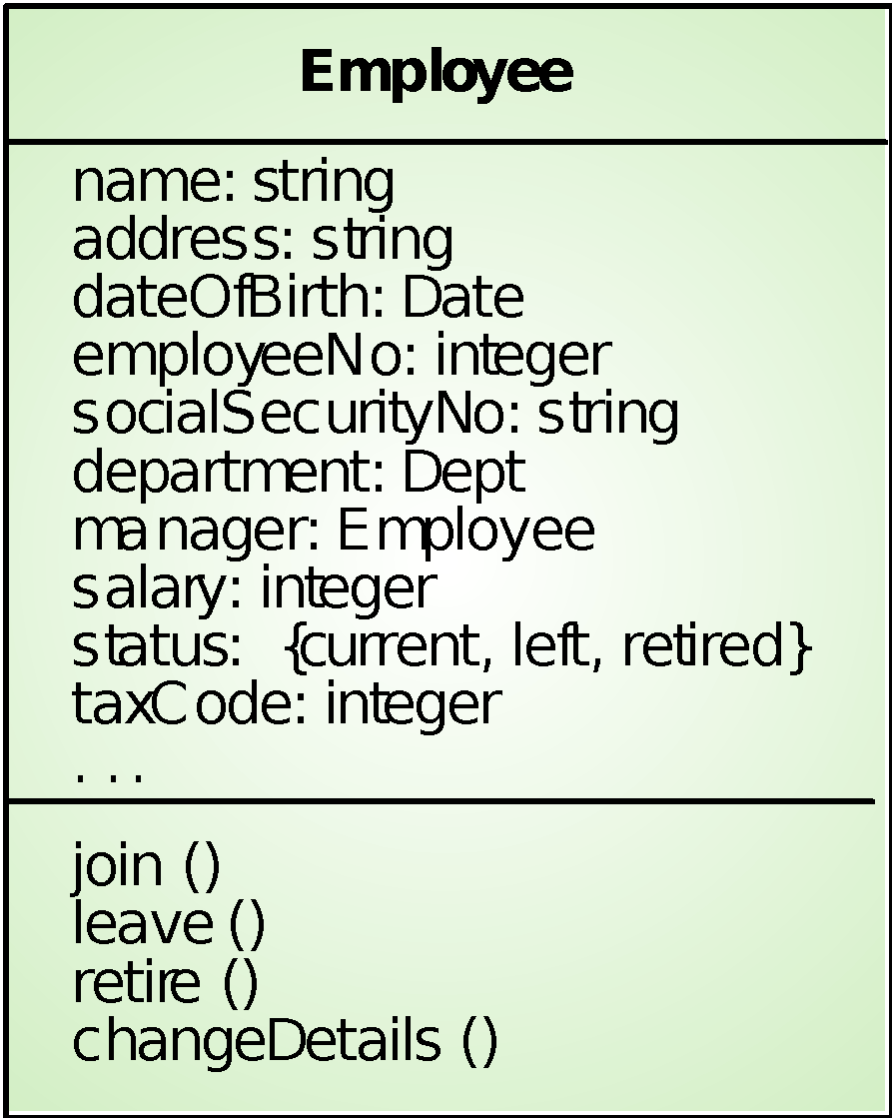
Employee object class (UML)
Object attributes
Services to other objects

Slide 16
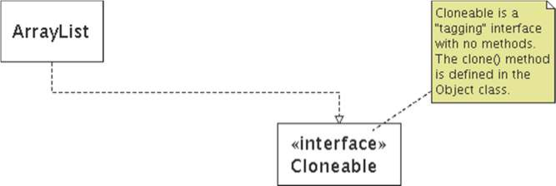
Comments
represented as a folded note, attached to the appropriate class/method/etc by a dashed line

Slide 17
Relationships
Class diagrams may contain the following relationships:
Association, aggregation, dependency, realize, and inheritance
Notation:
Association
Aggregation
Dependency
Inheritance
Realize

Slide 18
UML Class Notation
Lines or arrows between classes indicate relationships
Association
A relationship between instances of two classes, where one class must know about the other to do its work, e.g. client communicates to server
indicated by a straight line or arrow
Aggregation
An association where one class belongs to a collection, e.g. instructor part of Faculty
Indicated by an empty diamond on the side of the collection
Composition
Strong form of Aggregation
Lifetime control; components cannot exist without the aggregate
Indicated by a solid diamond on the side of the collection
Inheritance
An inheritance link indicating one class a superclass relationship, e.g. bird is part of mammal
Indicated by triangle pointing to superclass

Slide 19
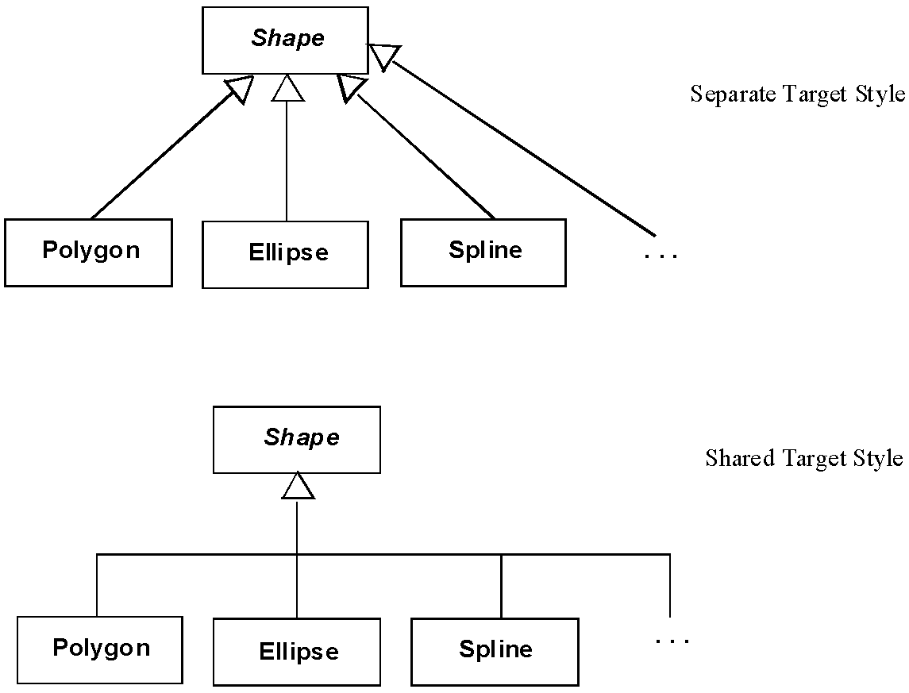
Generalization

Slide 20
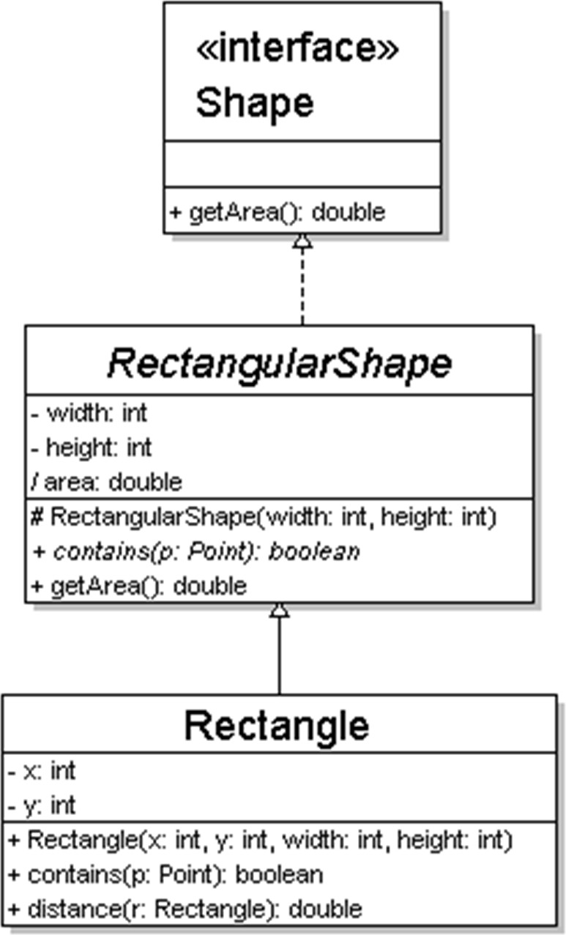
Generalization (inheritance) relationships
hierarchies drawn top-down
arrows point upward to parent
line/arrow styles indicate whether parent is a(n):
class:
solid line, black arrow
abstract class:
solid line, white arrow
interface:
dashed line, white arrow
often omit trivial / obvious generalization relationships, such as drawing the Object class as a parent

Slide 21
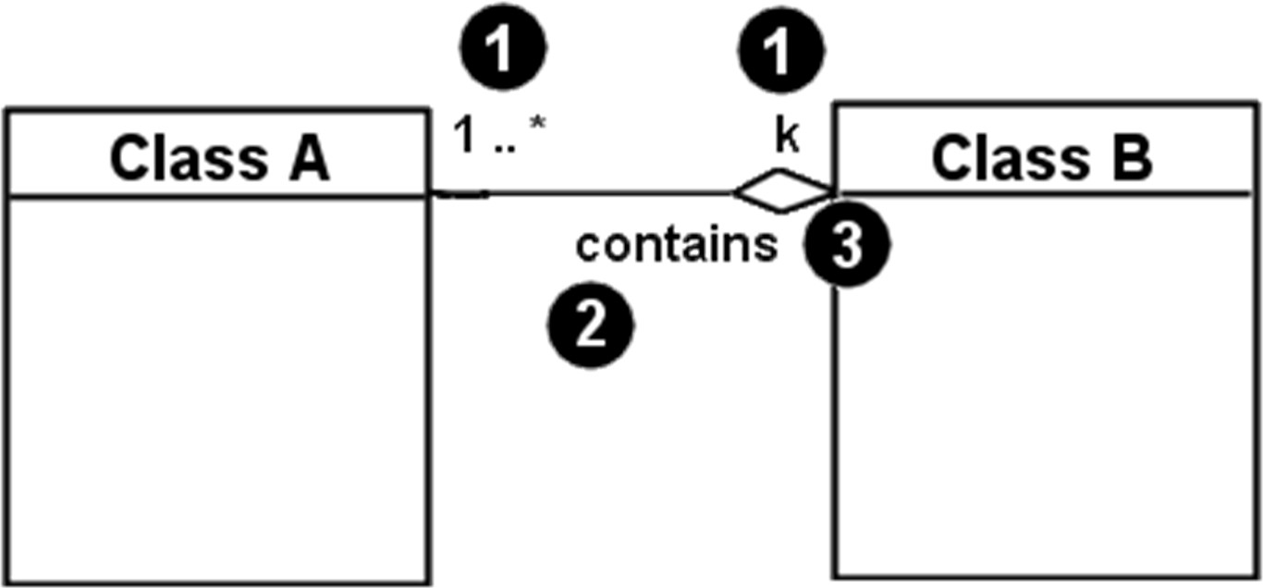
Associational relationships
associational (usage) relationships
1. multiplicity
(how many are used)
* ⇒ 0, 1, or more
1 ⇒ 1 exactly
2..4 ⇒ between 2 and 4, inclusive
3..* ⇒ 3 or more (also written as “3..”)
name
navigability
(what relationship the objects have)
(direction)

Slide 22
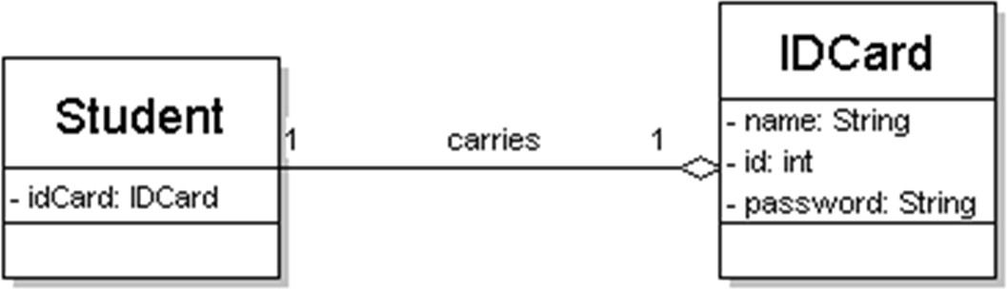
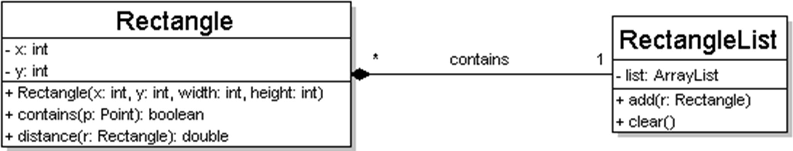
Multiplicity of associations
one-to-one
each student must carry exactly one ID card
one-to-many
one rectangle list can contain many rectangles

Slide 23
Association types
Car
1
1
aggregation: “is part of”
– symbolized by a clear white diamond
aggregation
Engine
composition: “is entirely made of”
stronger version of aggregation
the parts live and die with the whole
symbolized by a black diamond
Book
composition
1
*
Page
dependency: “uses temporarily”
symbolized by dotted line
often is an implementation
dependency
detail, not an intrinsic part of that object's state
Lottery Ticket
Random

Slide 24
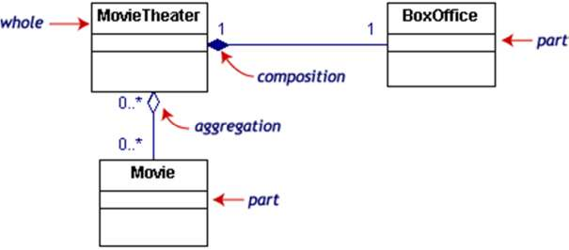
Composition/aggregation example
If the movie theater goes away
so does the box office => composition but movies may still exist => aggregation

Slide 25
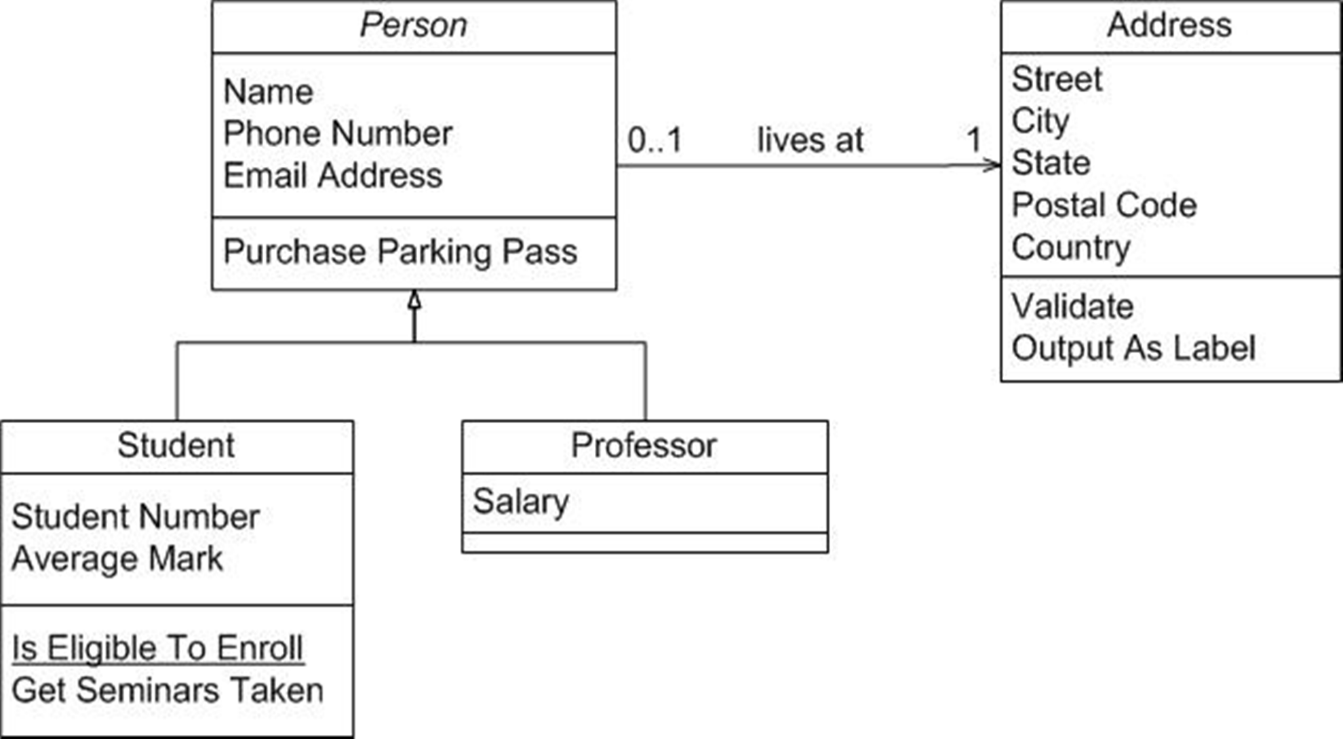
UML example: people
Let’s add the visibility attributes

Slide 26
Class diagram example: student
Student
firstName : String
lastName : String
homeAddress : Address
schoolAddress : Address
+ toString() : String
StudentBody
1
100
+ main (args : String[])
Address
streetAddress : String
city : String
state : String
zipCode : long
+ toString() : String

Slide 27
Class diagram pros/cons
Class diagrams are great for:
discovering related data and attributes
getting a quick picture of the important entities in a system
seeing whether you have too few/many classes
seeing whether the relationships between objects are too complex, too many in number, simple enough, etc.
spotting dependencies between one class/object and another
Not so great for:
discovering algorithmic (not data-driven) behavior
finding the flow of steps for objects to solve a given problem
understanding the app's overall control flow (event-driven? web-based? sequential? etc.)

Slide 28
Object Diagrams
Shows instances of Class Diagrams and links among them
An object diagram is a snapshot of the objects in a system
At a point in time
With a selected focus
Interactions – Sequence diagram
Message passing – Collaboration diagram
Operation – Deployment diagram

Slide 29
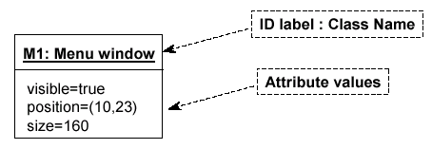
Object Diagrams
Format is
Instance name : Class name
Attributes and Values
Example:

Slide 30
UML diagrams: use cases
A use case encodes a typical user interaction with the system. In particular, it:
captures some user-visible function.
achieves some concrete goal for the user.
A complete set of use cases largely defines the requirements for your system: everything the user can see, and would like to do.
The granularity of your use cases determines the number of them (for you system). A clear design depends on showing the right level of detail.
A use case maps actors to functions. The actors need not be people.

Slide 31

Use case examples, 1 (High-level use case for powerpoint.)

Slide 32
About the last example...
Although this is a valid use case for powerpoint, and it completely captures user interaction with powerpoint, it’s too vague to be useful.

Slide 33
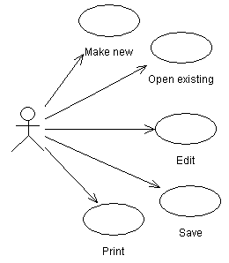
Use case examples, 2 (Finer-grained use cases for powerpoint.)

Slide 34
About the last example...
The last example gives a more useful view of powerpoint (or any similar application).
The cases are vague, but they focus your attention the key features, and would help in developing a more detailed requirements specification.
It still doesn’t give enough information to characterize powerpoint, which could be specified with tens or hundreds of use cases (though doing so might not be very useful either).

Slide 35
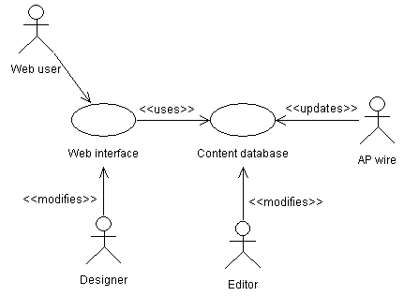
Use case examples, 3 (Relationships in a news web site.)

Slide 36
About the last example...
The last is more complicated and realistic use case diagram. It captures several key use cases for the system.
Note the multiple actors. In particular, ‘AP wire’ is an actor, with an important interaction with the system, but is not a person (or even a computer system, necessarily).
The notes between << >> marks are stereotypes: identifiers added to make the diagram more informative. Here they differentiate between different roles (ie, different meanings of an arrow in this diagram).

